Slide 1


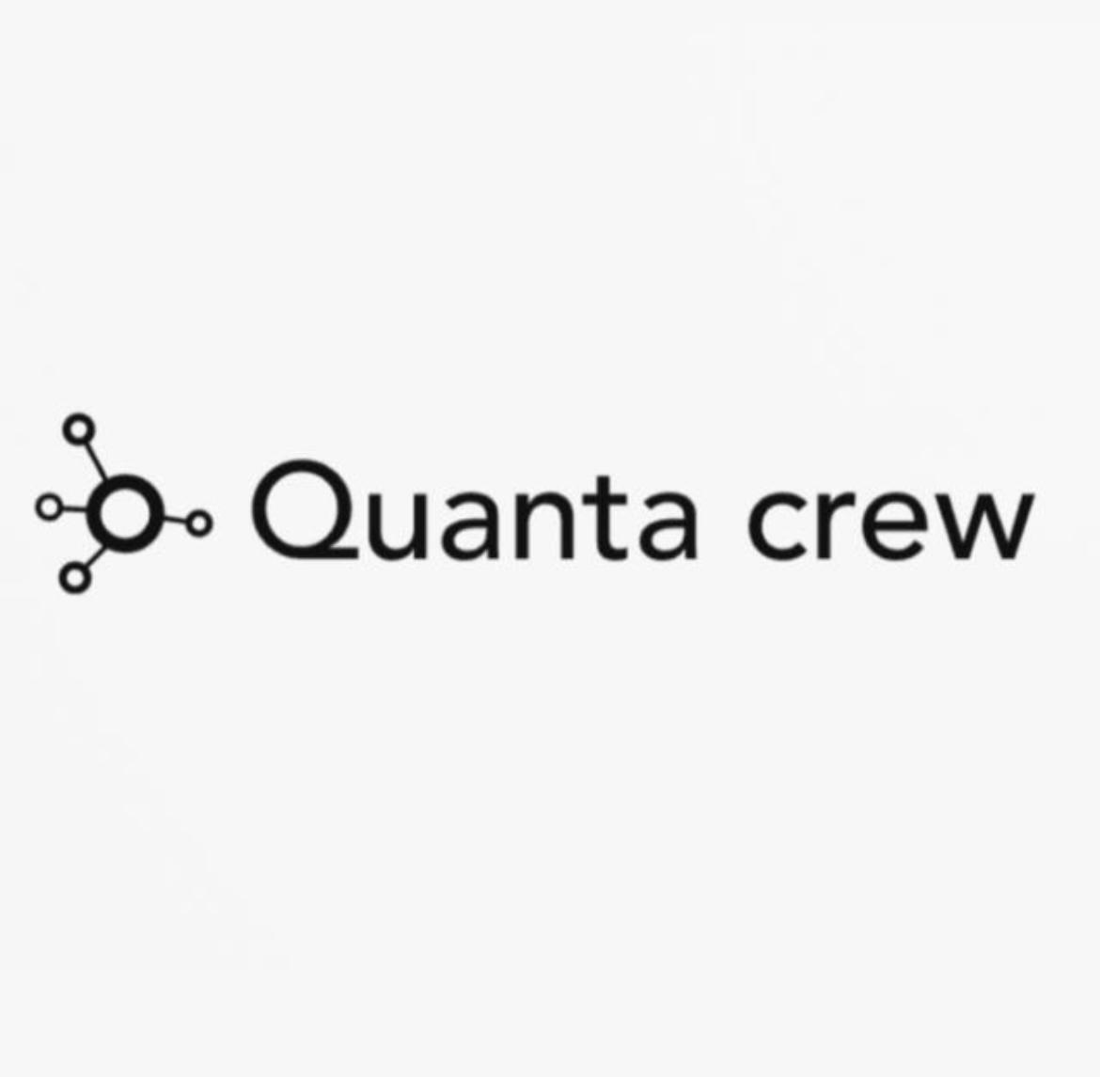
Lexivion
TEAM NAME : VectorVerse
THEME/TRACK : Artificial Intelligence / Machine Learning

Slide 2
Problem Statement
Organizations today—businesses, hospitals, universities, legal firms, and government offices—are drowning in unstructured documents such as PDFs, reports, manuals, policies, contracts, academic material, and scanned images.These documents contain critical information, but retrieving the correct answer at the right time is slow, frustrating, and error-prone.
Why This Problem is Important?
✔ It directly affects productivityStudies show 20–30% of employee time is wasted searching for information.
✔ It affects accuracyMisinterpreting or missing critical documents can lead to operational, legal, or medical errors.
✔ It enables faster decisionsRapid access to the right information empowers smarter choices in daily operations.
✔ It supports digital transformationA smart document assistant is a key requirement in the AI-enabled era.
✔ It democratizes knowledgeEven non-technical users should be able to ask questions naturally and get reliable answers instantly.

Slide 3
Proposed Solution
Our idea is to build Lexivion — an intelligent, AI-powered document assistant that can understand, process, and answer questions from complex PDFs using both text and images.
It transforms unstructured documents into a searchable knowledge engine using:
Text embedding
Image embedding
Vector similarity search
A multi-modal RAG pipeline
Gemini for structured, accurate answers
This means a user can upload any PDF—reports, manuals, legal paperwork, academic content—and ask natural-language questions like:
“Summarize page 10,”
“What is the procedure for patient discharge?”
“Show me the diagram for the electrical circuit,”
“Explain the financial summary of the report.”
And the system returns clear, accurate, evidence-linked answers supported by both text and images extracted from the document.

Slide 4
Tech Stack
Frontend (User Interface)
React + Vite — Fast, modern UI framework and bundler
Tailwind CSS — Lightweight styling for a responsive interface
Axios — For API communication
PDF Modal Viewer — Displays PDF pages dynamically
LocalStorage Auth Tokens — Stores user login session
Backend (API + Core Logic)
Flask (Python) — REST API framework
Blueprints — Modular route separation
itsdangerous — Token-based authentication
Pydantic-like validations (manual)
Python Services Architecture
Database + Storage
PostgreSQL — Main data store
pgvector — Similarity search for embeddings
JSONB + GIN Indexing — For metadata and fast filtering
Base64 Image Storage — Stores extracted PDF images
Migrations (SQL scripts) — Version-controlled DB schema
AI + ML Components
Text Embeddings
BGE (BAAI General Embedding)
Image Embeddings
CLIP ViT-H-14
LLM
Google Gemini

Slide 5
Expected Outcome / Impact
Lexivion provides a smart framework capable of comprehending, processing and answering questions in difficult PDFs in real time, both in the form of text and in the form of images.
After the project is done, it will enable the users to:
Upload any PDF (reports, manuals, policies, academic content, legal papers, etc.)
Ask natural-language questions
Receive accurate, structured answers with referenced text and images
Preview the exact pages and sections where the answer came from
Navigate documents faster and more intelligently than traditional search tools
This creates a powerful, user-friendly document intelligence platform that works across industries.
Impact of the Project
Significantly reduces time spent searching through long documents - Users find answers in seconds instead of hours.
Improves accuracy and reduces human errors - Answers come directly from document sources, lowering the risk of misinterpretation.
Enables natural language querying of complex PDFs - Anyone can extract insights without technical knowledge or manual reading.
Makes documents with images, charts, and diagrams searchable - Multimodal intelligence handles content traditional keyword search cannot.
Boosts productivity across industries - Useful for education, healthcare, legal, business, HR, operations, and research.

Slide 6
Team Details
Team Lead: Joderick Sherwin J
College Name: Rajalakshmi Engineering College
Email: 220701109@Rajalakshmi.edu.in
Phone: +91 70949 44667
Member 2: Karthiga R
College Name: Rajalakshmi Engineering College
Email: 220701119@Rajalakshmi.edu.in
Phone: +91 93448 20905

